Slide 1
Distributed Systems
Synchronization
Chapter 6

Slide 2
Course/Slides Credits
Note: all course presentations are based on those developed by Andrew S. Tanenbaum and Maarten van Steen. They accompany their "Distributed Systems: Principles and Paradigms" textbook (1st & 2nd editions).
http://www.prenhall.com/divisions/esm/app/author_tanenbaum/custom/dist_sys_1e/index.html
And additions made by Paul Barry in course CW046-4: Distributed Systems
http://glasnost.itcarlow.ie/~barryp/net4.html

Slide 3
Why Synchronize?
Often important to control access to a single,
shared resource.
Also often important to agree on the ordering of events.
Synchronization in Distributed Systems is much more difficult than in uniprocessor systems.
We will study:
Synchronization based on “Actual Time”.
Synchronization based on “Relative Time”.
Synchronization based on Co-ordination (with Election Algorithms).
Distributed Mutual Exclusion.
Distributed Transactions.

Slide 4
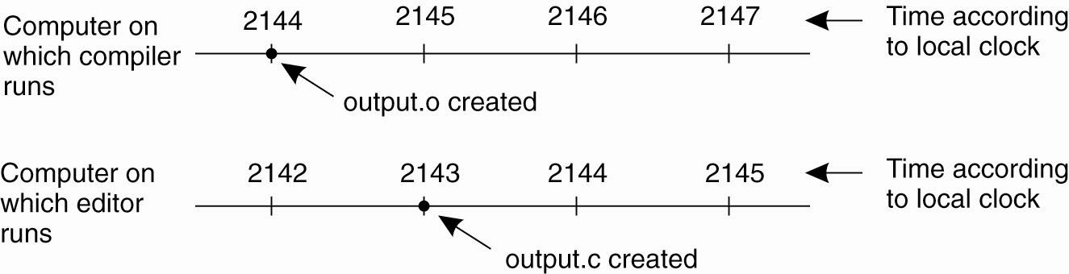
Clock Synchronization
When each machine has its own clock, an event that occurred after another event may nevertheless be assigned an earlier time

Slide 5
Clock Synchronization
Synchronization based on “Actual Time”.
Note: time is really easy on a uniprocessor system.
Achieving agreement on time in a DS is not trivial.
Question: is it even possible to synchronize all the clocks in a Distributed System?
With multiple computers, “clock skew” ensures that
no two machines have the same value for the “current time”. But, how do we measure time?

Slide 6
How Do We Measure Time?
Turns out that we have only been measuring time accurately with a “global” atomic clock since Jan. 1st, 1958 (the “beginning of time”).
Bottom Line: measuring time is not as easy as one might think it should be.
Algorithms based on the current time (from some Physical Clock) have been devised for use within a DS.

Slide 7
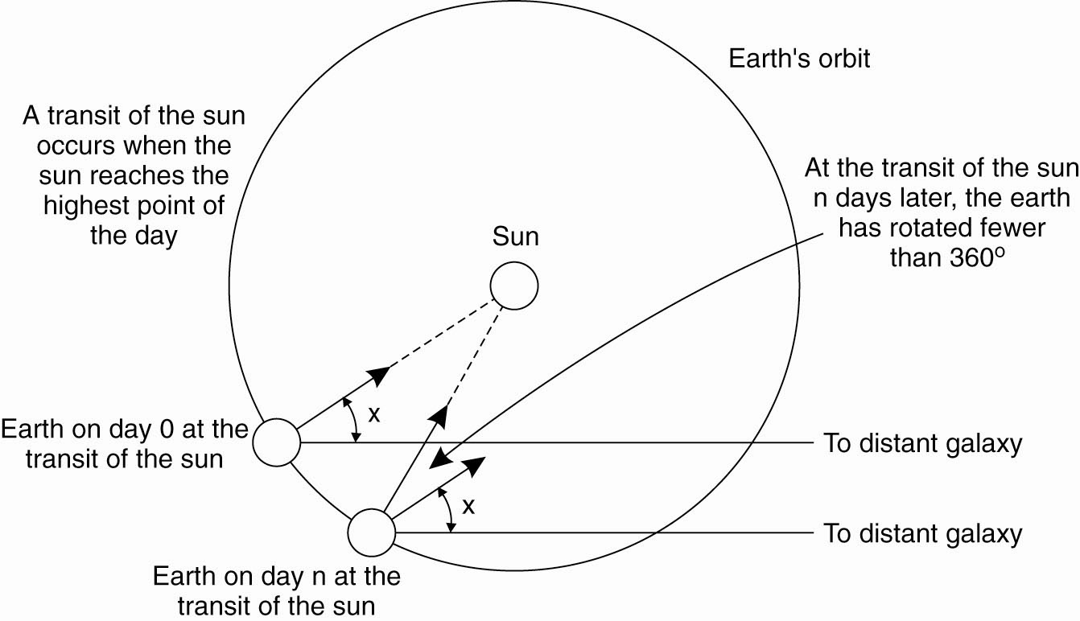
Physical Clocks (1)
Computation of the mean solar day

Slide 8
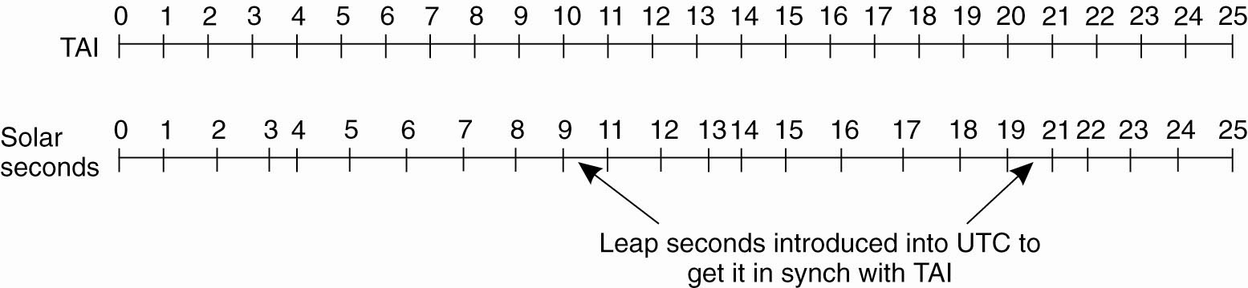
Physical Clocks (2)
TAI seconds are of constant length, unlike solar seconds. Leap seconds are introduced when necessary to keep in phase with the sun

Slide 9
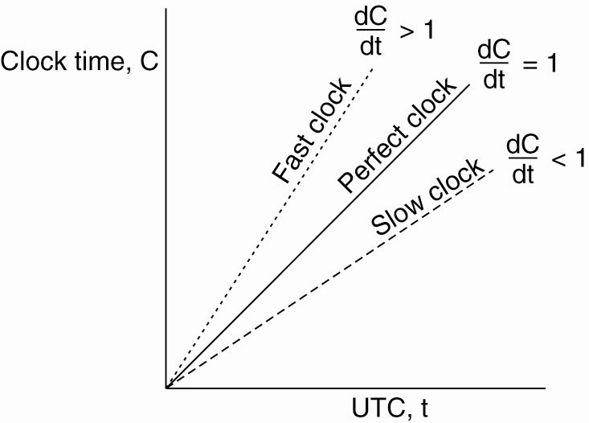
Physical Clocks (3)
The relation between clock time and UTC
when clocks tick at different rates

Slide 10
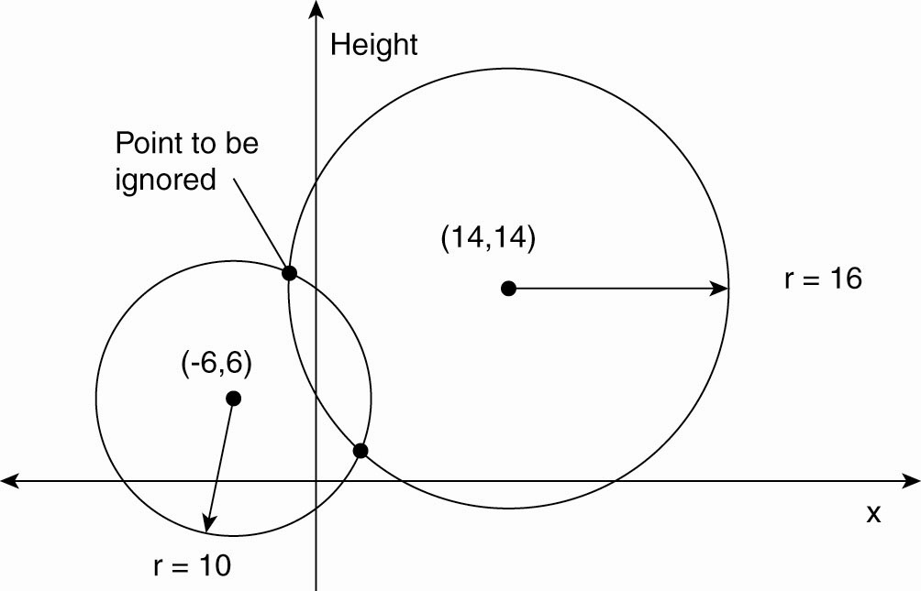
Global Positioning System (1)
Computing a position in a two-dimensional space

Slide 11
Global Positioning System (2)
Real world facts that complicate GPS:
It takes a while before data on a satellite’s position reaches the receiver.
The receiver’s clock is generally not in synch with that of a satellite.

Slide 12
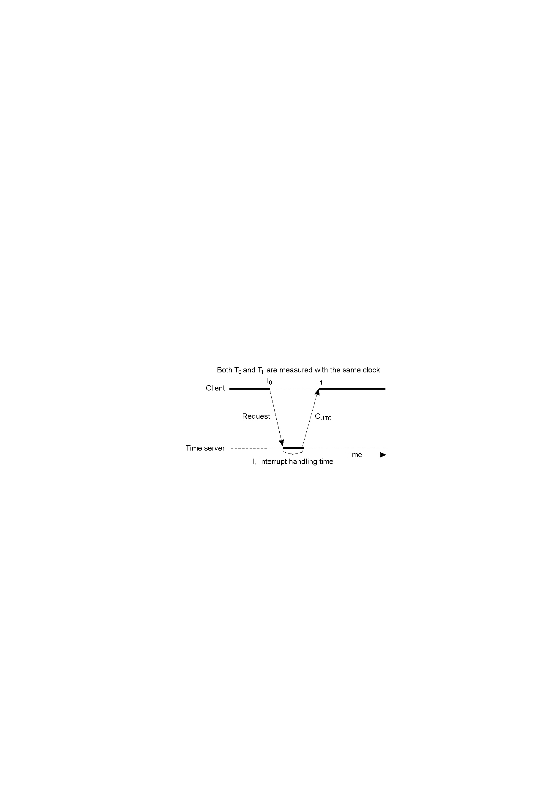
Clock Synchronization
Cristian's Algorithm
Getting the current time from a “time server”, using periodic client requests.
Major problem if time from time server is less than the client – resulting in time running backwards on the client! (Which cannot happen – time does not go backwards).
Minor problem results from the delay introduced by the network request/response: latency.

Slide 13
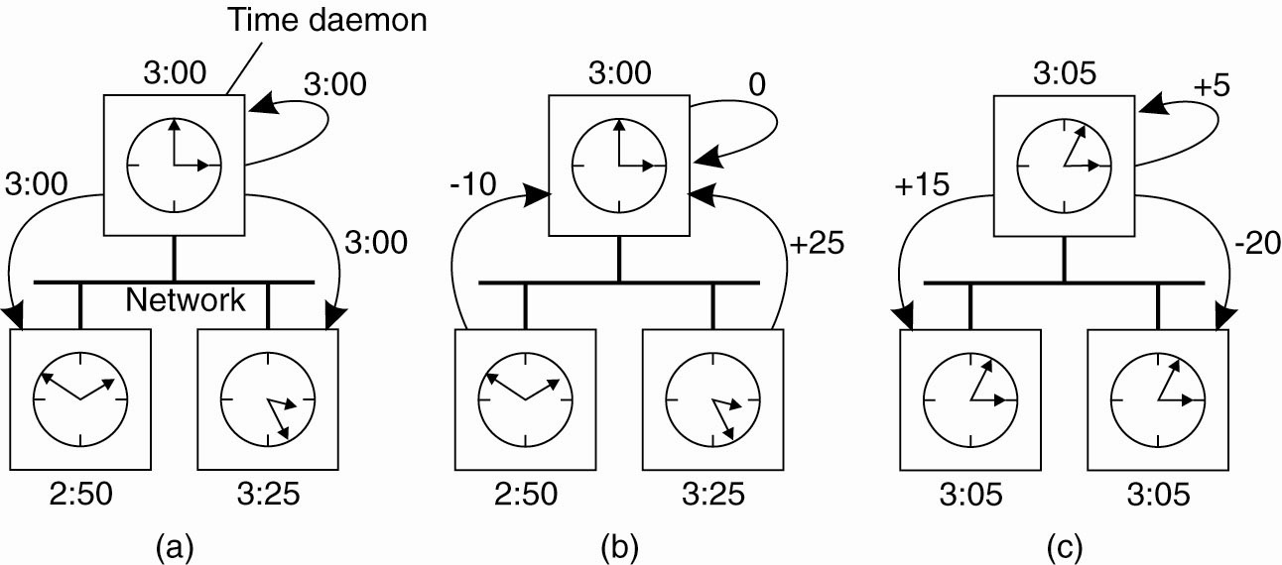
The Berkeley Algorithm (1)
(a) The time daemon asks all the other machines for their clock values

Slide 14
The Berkeley Algorithm (2)
(b) The machines answer

Slide 15
The Berkeley Algorithm (3)
(c) The time daemon tells everyone
how to adjust their clock

Slide 16
Other Clock Sync. Algorithms
Both Cristian’s and the Berkeley Algorithm are centralized algorithms.
Decentralized algorithms also exist, and the Internet’s Network Time Protocol (NTP) is the best known and most widely implemented.
NTP can synchronize clocks to within a 1-50 msec accuracy.

Slide 17
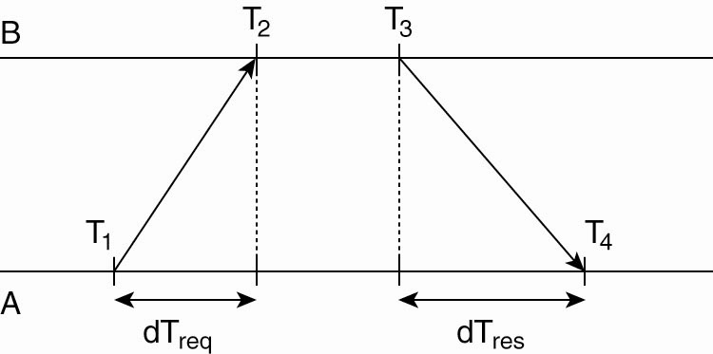
Network Time Protocol
Getting the current time from a time server

Slide 18
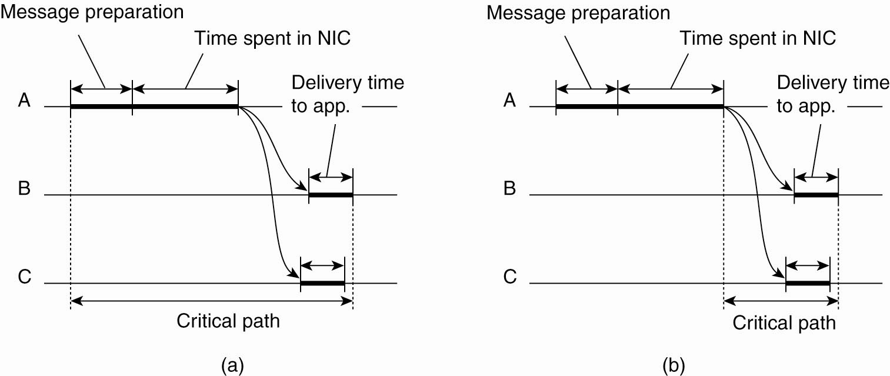
Clock Synchronization in Wireless Networks (1)
(a) The usual critical path in determining network delays

Slide 19
Clock Synchronization in Wireless Networks (2)
(b) The critical path in the case of RBS

Slide 20
Logical Clocks
Synchronization based on “relative time”.
Note that (with this mechanism) there is no requirement for “relative time” to have any relation to the “real time”.
What’s important is that the processes in the Distributed System agree on the ordering in which certain events occur.
Such “clocks” are referred to as Logical Clocks.

Slide 21
Lamport’s Logical Clocks
First point: if two processes do not interact, then their clocks do not need to be synchronized – they can operate concurrently without fear of interfering with each other.
Second (critical) point: it does not matter that two processes share a common notion of what the “real” current time is. What does matter is that the processes have some agreement on the order in which certain events occur.
Lamport used these two observations to define the “happens-before” relation (also often referred to within the context of Lamport’s Timestamps).

Slide 22
The “Happens-Before” Relation (1)
If A and B are events in the same process, and A occurs before B, then we can state that:
A “happens-before” B is true.
Equally, if A is the event of a message being sent by one process, and B is the event of the same message being received by another process, then A “happens-before” B is also true.
(Note that a message cannot be received before it is sent, since it takes a finite, nonzero amount of time to arrive … and, of course, time is not allowed to run backwards).

Slide 23
The “Happens-Before” Relation (2)
Obviously, if A “happens-before” B and B “happens-before” C, then it follows that A “happens-before” C.
If the “happens-before” relation holds, deductions about the current clock “value”
on each DS component can then be made.
It therefore follows that if C(A) is the time
on A, then C(A) < C(B), and so on.
If two events on separate sites have same time, use unique PIDs to break the tie.

Slide 24
The “Happens-Before” Relation (3)
Now, assume three processes are in a DS: A, B and C.
All have their own physical clocks (which are running at differing rates due to “clock skew”, etc.).
A sends a message to B and includes a “timestamp”.
If this sending timestamp is less than the time of arrival at B, things are OK, as the “happens-before” relation still holds (i.e., A “happens-before” B is true).
However, if the timestamp is more than the time of arrival at B, things are NOT OK (as A “happens-before” B is not true, and this cannot be as the receipt of a message has to occur after it was sent).

Slide 25
The “Happens-Before” Relation (4)
The question to ask is:
  How can some event that “happens-before” some other event possibly have occurred at a later time??
The answer is: it can’t!
So, Lamport’s solution is to have the receiving process adjust its clock forward to one more than the sending timestamp value. This allows the “happens-before” relation to hold, and also keeps all the clocks running in a synchronized state. The clocks are all kept in sync relative to each other.

Slide 26
Lamport’s Logical Clocks (1)
The "happens-before" relation →
can be observed directly in two situations:
If a and b are events in the same process,
and a occurs before b, then a → b is true.
If a is the event of a message being sent by one process, and b is the event of the
message being received by another process, then a → b.

Slide 27
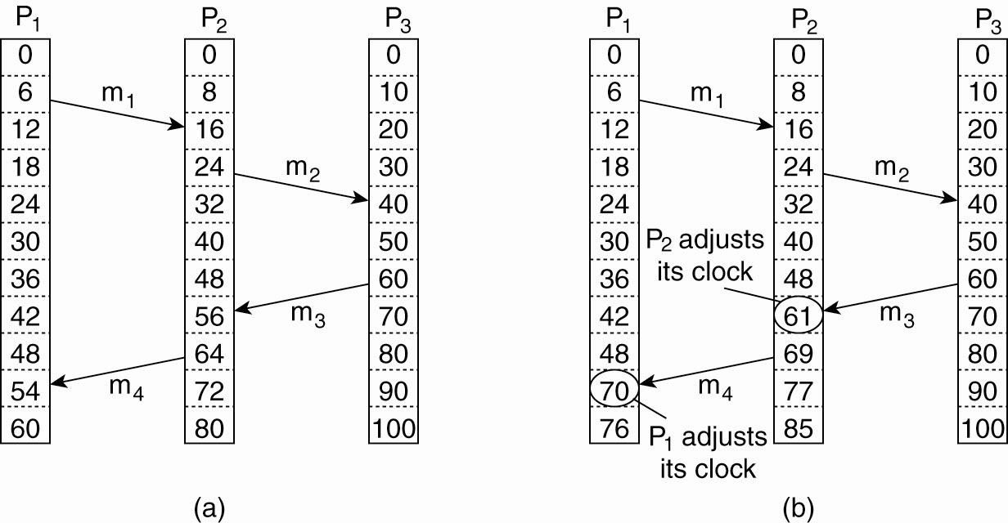
Lamport’s Logical Clocks (2)
(a) Three processes, each with its own clock.
The clocks run at different rates.

Slide 28
Lamport’s Logical Clocks (3)
(b) Lamport’s algorithm corrects the clocks

Slide 29
Lamport’s Logical Clocks (4)
Updating counter C_{i} for process P_{i} :
Before executing an event P_{i} executes
C_{i} ← C_{i} + 1.
When process P_{i} sends a message m to P_{j},
it sets m’s timestamp ts(m) equal to C_{i}
after having executed the previous step.
Upon the receipt of a message m, process P_{j} adjusts its own local counter as
C_{j} ← max{C_{j} , ts(m)}, after which it then executes the first step and delivers the message to the application.

Slide 30
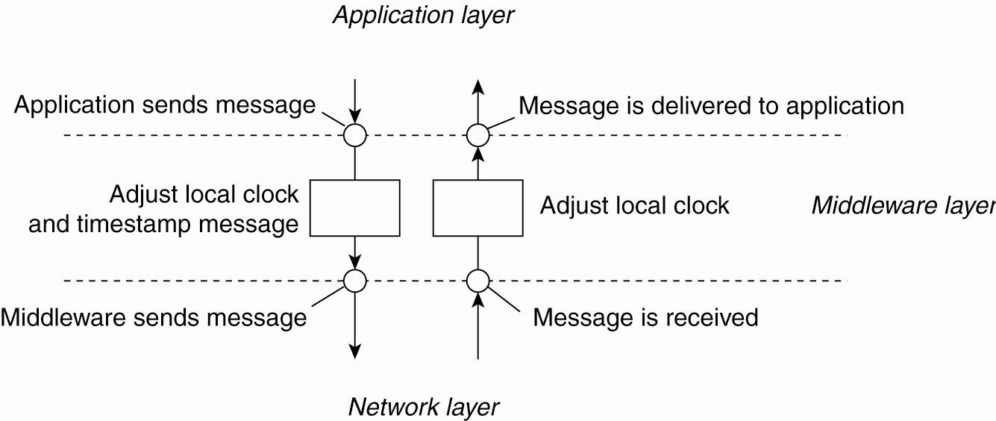
Lamport’s Logical Clocks (5)
The positioning of Lamport’s logical
clocks in distributed systems

Slide 31
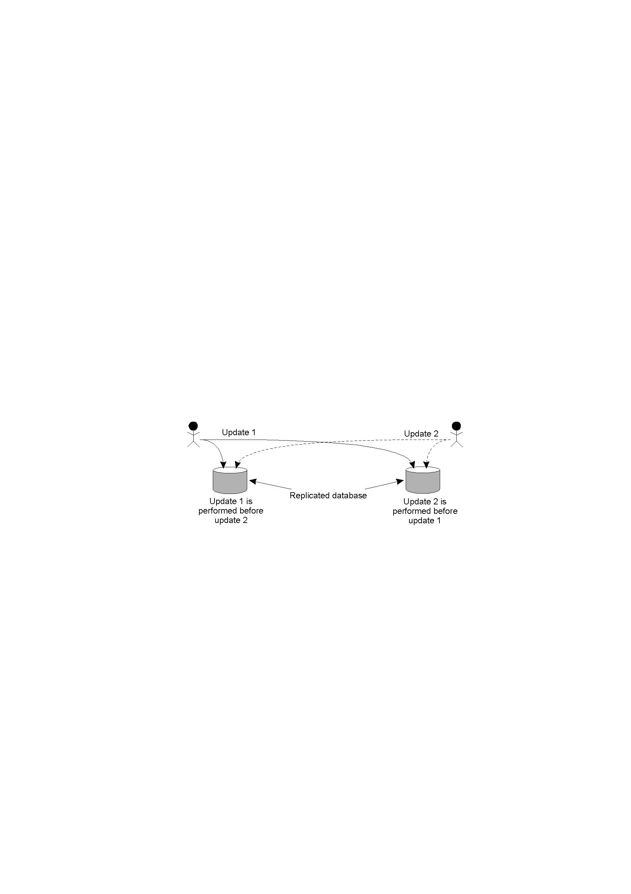
Problem: Totally-Ordered Multicasting
Updating a replicated database and leaving it in an inconsistent state: Update 1 adds 100 euro to an account, Update 2 calculates and adds 1% interest to the same account. Due to network delays, the updates may not happen in the correct order. Whoops!

Slide 32
Solution: Totally-Ordered Multicasting
A multicast message is sent to all processes in the group, including the sender, together with the sender’s timestamp.
At each process, the received message is added to a local queue, ordered by timestamp.
Upon receipt of a message, a multicast acknowledgement/timestamp is sent to the group.
Due to the “happens-before” relationship holding, the timestamp of the acknowledgement is always greater than that of the original message.

Slide 33
More Totally Ordered Multicasting
Only when a message is marked as acknowledged by all the other processes will it be removed from the queue and delivered to a waiting application.
Lamport’s clocks ensure that each message has a unique timestamp, and consequently, the local queue at each process eventually contains the same contents.
In this way, all messages are delivered/processed in the same order everywhere, and updates can occur in a consistent manner.

Slide 34
Totally-Ordered Multicasting, Revisited
Update 1 is time-stamped and multicast. Added to local queues.
Update 2 is time-stamped and multicast. Added to local queues.
Acknowledgements for Update 2 sent/received. Update 2 can now be processed.
Acknowledgements for Update 1 sent/received. Update 1 can now be processed.
(Note: all queues are the same, as the timestamps have been used to ensure the “happens-before” relation holds.)

Slide 35
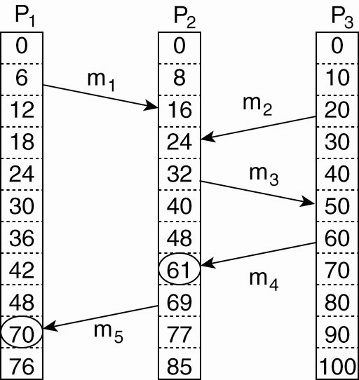
Vector Clocks (1)
Concurrent message transmission using logical clocks

Slide 36
Vector Clocks (2)
Vector clocks are constructed by letting each process P_{i} maintain a vector VC_{i} with the following two properties:
VC_{i} [ i ] is the number of events that have occurred so far at P_{i}. In other words, VC_{i} [ i ] is the local logical clock at process P_{i} .
If VC_{i} [ j ] = k then P_{i} knows that k events have occurred at P_{j}. It is thus P_{i}’s knowledge of the local time at P_{j} .

Slide 37
Vector Clocks (3)
Steps carried out to accomplish property 2 of previous slide:
Before executing an event, P_{i} executes
VC_{i} [ i ] ← VC_{i} [i ] + 1.
When process P_{i} sends a message m to P_{j}, it sets m’s (vector) timestamp ts(m) equal to VC_{i} after having executed the previous step.
Upon the receipt of a message m, process P_{j}
adjusts its own vector by setting
VC_{j} [k ] ← max{VC_{j} [k ], ts(m)[k ]} for each k,
after which it executes the first step and delivers
the message to the application.

Slide 38
Mutual Exclusion within Distributed Systems
It is often necessary to protect a shared resource within a Distributed System using “mutual exclusion” – for example, it might be necessary to ensure that no other process changes a shared resource while another process is working with it.
In non-distributed, uniprocessor systems, we can implement “critical regions” using techniques such as semaphores, monitors and similar constructs – thus achieving mutual exclusion.
These techniques have been adapted to Distributed Systems …

Slide 39
DS Mutual Exclusion: Techniques
Centralized: a single coordinator controls whether a process can enter a critical region.
Distributed: the group confers to determine whether or not it is safe for a process to enter a critical region.

Slide 40
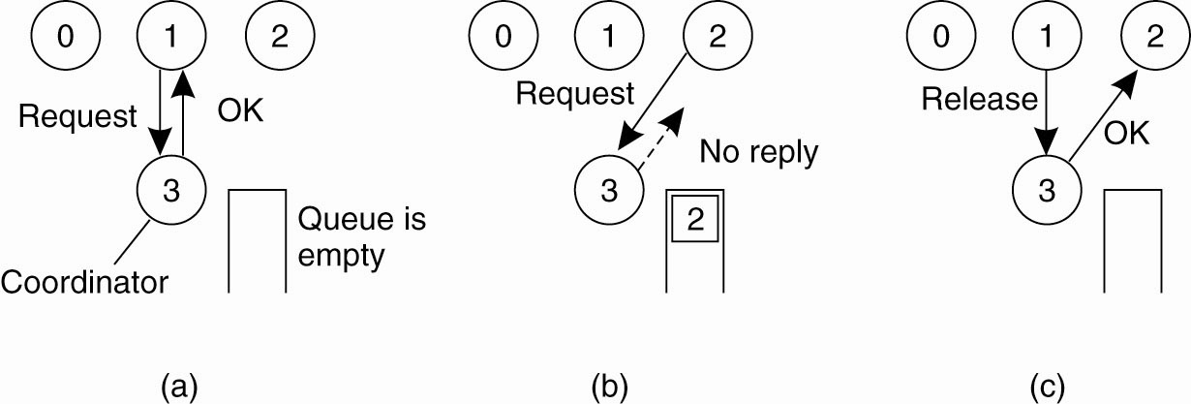
Mutual Exclusion
A Centralized Algorithm (1)
(a) Process 1 asks the coordinator for permission to access a shared resource. Permission is granted.

Slide 41
Mutual Exclusion
A Centralized Algorithm (2)
b) Process 2 then asks permission to access the same resource. The coordinator does not reply.

Slide 42
Mutual Exclusion
A Centralized Algorithm (3)
(c) When process 1 releases the resource, it tells the coordinator, which then replies to 2

Slide 43
Comments: The Centralized Algorithm
Advantages:
  It works.
  It is fair.
  There’s no process starvation.
  Easy to implement.
Disadvantages:
  There’s a single point of failure!
  The coordinator is a bottleneck on busy systems.
Critical Question: When there is no reply, does this mean that the coordinator is “dead” or just busy?

Slide 44
Distributed Mutual Exclusion
Based on work by Ricart and Agrawala (1981).
Requirement of their solution: total ordering of all events in the distributed system (which is achievable with Lamport’s timestamps).
Note that messages in their system contain three pieces of information:
  The critical region ID.
  The requesting process ID.
  The current time.

Slide 45
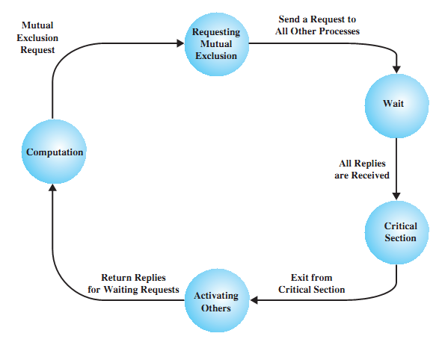
Skeleton State Diagram for a Process

Slide 46
Mutual Exclusion: Distributed Algorithm
When a process (the “requesting process”) decides to enter a critical region, a message is sent to all processes in the Distributed System (including itself).
What happens at each process depends on the “state” of the critical region.
If not in the critical region (and not waiting to enter it), a process sends back an OK to the requesting process.
If in the critical region, a process will queue the request and will not send a reply to the requesting process.
If waiting to enter the critical region, a process will:
    Compare the timestamp of the new message with that in its queue (note that the lowest timestamp wins).
    If the received timestamp wins, an OK is sent back, otherwise the request is queued (and no reply is sent back).
When all the processes send OK, the requesting process can safely enter the critical region.
When the requesting process leaves the critical region, it sends an OK to all the processes in its queue, then empties its queue.

Slide 47
Distributed Algorithm (1)
Three different cases:
If the receiver is not accessing the resource and does not want to access it, it sends back an OK message
to the sender.
If the receiver already has access to the resource,
it simply does not reply. Instead, it queues the request.
If the receiver wants to access the resource as well but has not yet done so, it compares the timestamp
of the incoming message with the one contained in the message that it has sent everyone. The lowest
one wins.

Slide 48
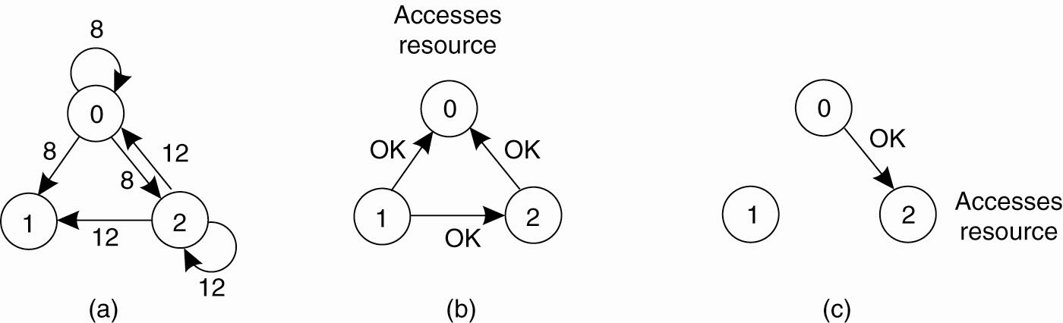
Distributed Algorithm (2)
(a) Two processes want to access a
shared resource at the same moment

Slide 49
Distributed Algorithm (3)
(b) Process 0 has the lowest timestamp, so it wins

Slide 50
Distributed Algorithm (4)
(c) When process 0 is done, it sends an OK also,
so 2 can now go ahead

Slide 51
Comments: The Distributed Algorithm
The algorithm works because in the case of a conflict, the lowest timestamp wins as everyone agrees on the total ordering of the events in the distributed system.
Advantages:
  It works.
  There is no single point of failure.
Disadvantages:
  We now have multiple points of failure!!!
  A “crash” is interpreted as a denial of entry to a critical region.
  (A patch to the algorithm requires all messages to be ACKed).
  Worse is that all processes must maintain a list of the current processes in the group (and this can be tricky)
  Worse still is that one overworked process in the system can become a bottleneck to the entire system – so, everyone slows down.

Slide 52
Which Just Goes To Show …
That it isn’t always best to implement a distributed algorithm when a reasonably good centralized solution exists.
Also, what’s good in theory (or on paper) may not be so good in practice.
Finally, think of all the message traffic this distributed algorithm is generating (especially with all those ACKs). Remember: every process is involved in the decision to enter the critical region, whether they have an interest in it or not (Oh dear … ).

Slide 53
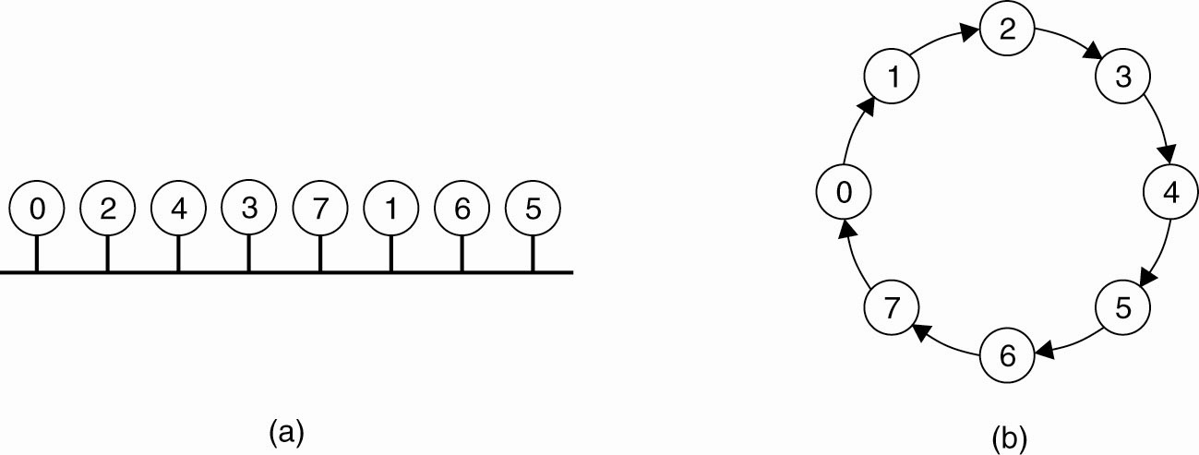
A Token Ring Algorithm
(a) An unordered group of processes on a network.
(b) A logical ring constructed in software.

Slide 54
Comments: Token-Ring Algorithm
Advantages:
  It works (as there’s only one token, so mutual exclusion is guaranteed).
  It’s fair – everyone gets a shot at grabbing the token at some stage.
Disadvantages:
  Lost token! How is the loss detected (it is in use or is it lost)? How is the token regenerated?
  Process failure can cause problems – a broken ring!
  Every process is required to maintain the current logical ring in memory – not easy.

Slide 55
Comparison: Mutual Exclusion Algorithms
Algorithm | Messages per entry/exit | Delay before entry (in message times) | Problems
Centralized | 3 | 2 | Coordinator crash
Distributed | 2 ( n – 1 ) | 2 ( n – 1 ) | Crash of any process
Token-Ring | 1 to ∞ | 0 to n – 1 | Lost token, process crash
None are perfect – they all have their problems!
The “Centralized” algorithm is simple and efficient, but suffers from a single point-of-failure.
The “Distributed” algorithm has nothing going for it – it is slow, complicated, inefficient of network bandwidth, and not very robust.
It “sucks”!
The “Token-Ring” algorithm suffers from the fact that it can sometimes take a long time to reenter a critical region having just exited it.

Slide 56
Election Algorithms
Many Distributed Systems require a process to act as coordinator (for various reasons). The selection of this process can be performed automatically by an “election algorithm”.
For simplicity, we assume the following:
  Processes each have a unique, positive identifier.
  All processes know all other process identifiers.
  The process with the highest valued identifier is duly elected coordinator.
When an election “concludes”, a coordinator has been chosen and is known to all processes.

Slide 57
Goal of Election Algorithms
The overriding goal of all election algorithms is to have all the processes in a group agree on a coordinator.
There are two types of election algorithm:
Bully: “the biggest guy in town wins”.
Ring: a logical, cyclic grouping.

Slide 58
Election Algorithms
The Bully Algorithm:
P sends an ELECTION message to all processes with higher numbers.
If no one responds, P wins the election and becomes coordinator.
If one of the higher-ups answers, it takes over. P’s job is done.

Slide 59
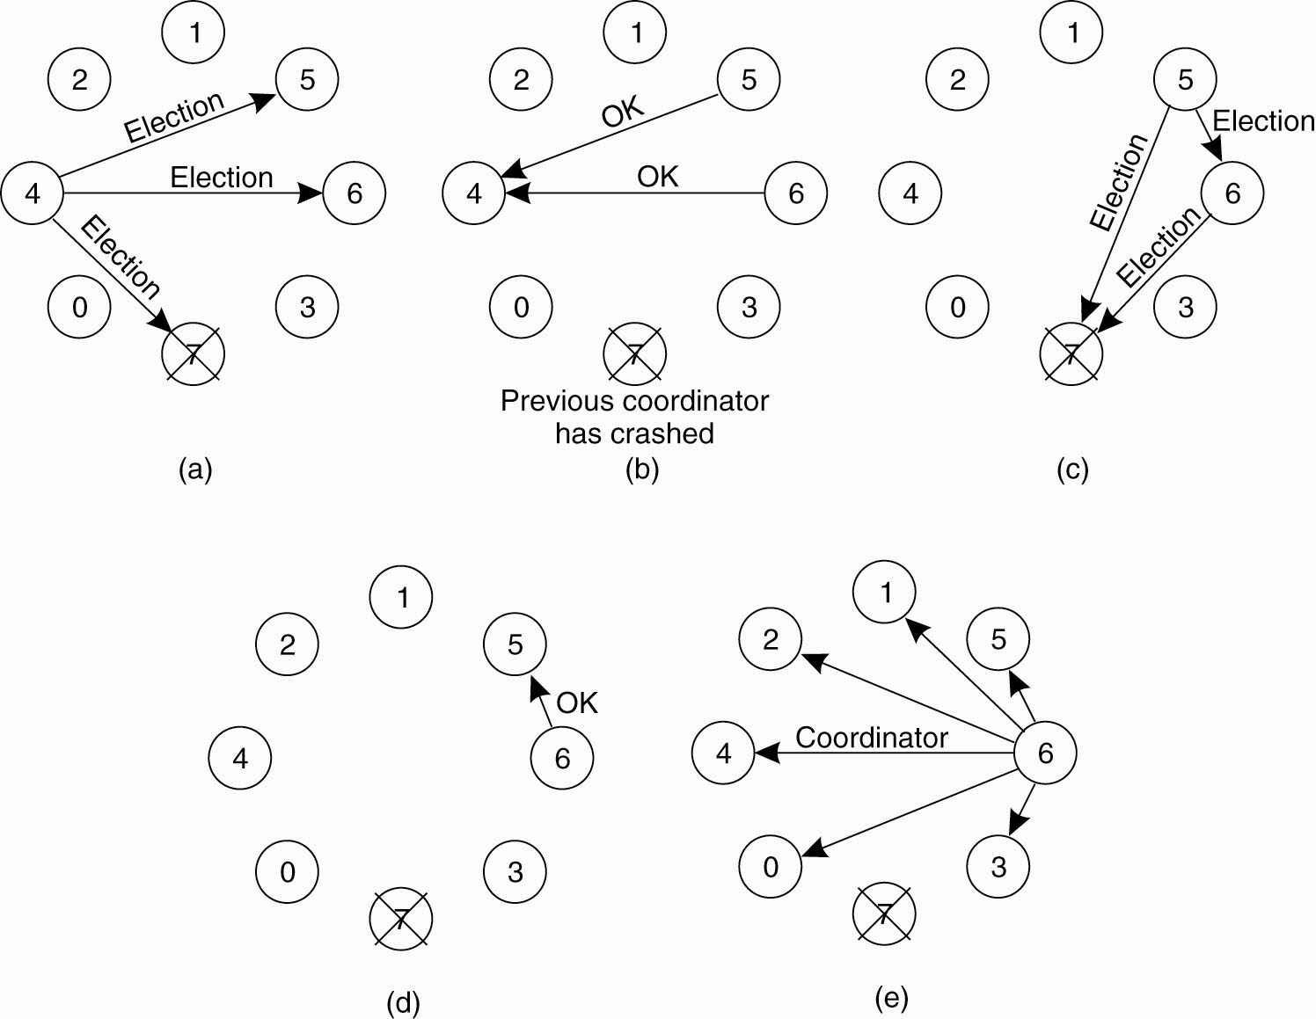
The Bully Algorithm (1)
The bully election algorithm:
(a) Process 4 holds an election.
(b) 5 and 6 respond, telling 4 to stop.
(c) Now 5 and 6 each hold an election.

Slide 60
The Bully Algorithm (2)
(d) Process 6 tells 5 to stop.
(e) Process 6 wins and tells everyone.

Slide 61
The “Ring” Election Algorithm
The processes are ordered in a “logical ring”, with each process knowing the identifier of its successor (and the identifiers of all the other processes in the ring).
When a process “notices” that a coordinator is down, it creates an ELECTION message (which contains its own number) and starts to circulate the message around the ring.
Each process puts itself forward as a candidate for election by adding its number to this message (assuming it has a higher numbered identifier).
Eventually, the original process receives its original message back (having circled the ring), determines who the new coordinator is, then circulates a COORDINATOR message with the result to every process in the ring.
With the election over, all processes can get back to work.

Slide 62
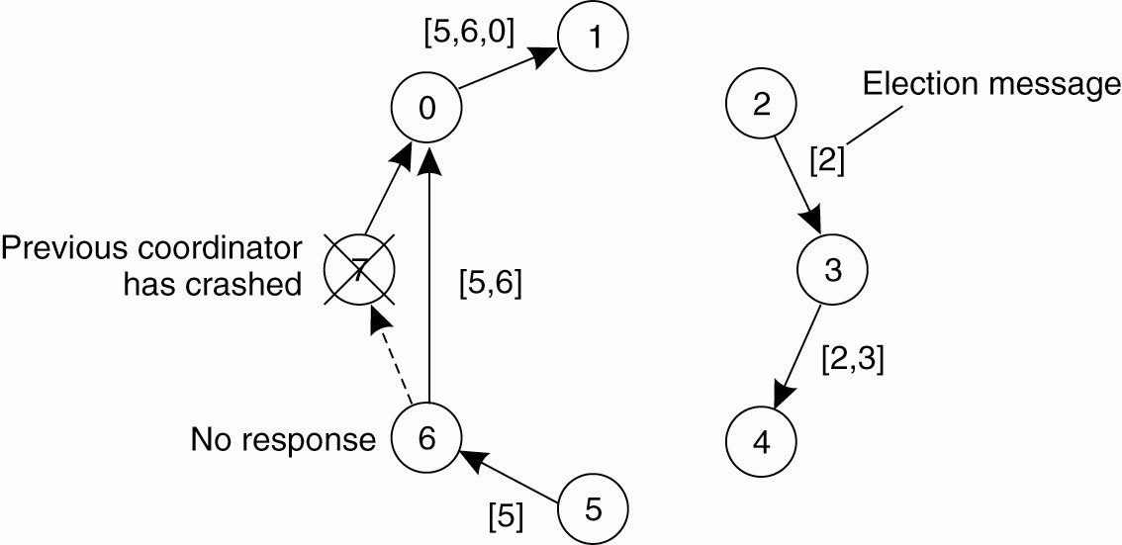
A Ring Algorithm
Election algorithm using a ring

Slide 63
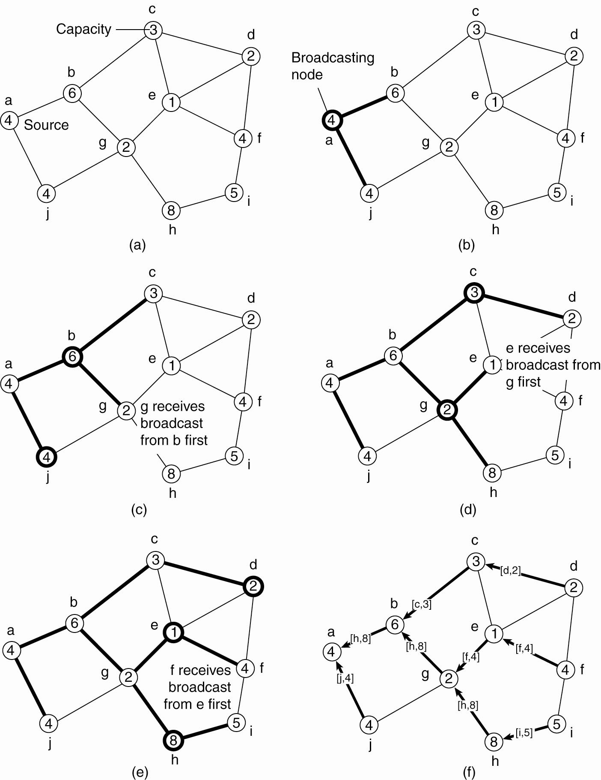
Elections in Wireless Environments (1)
Election algorithm in a wireless network, with node a as the source. (a) Initial network.
(b)–(e) The build-tree phase.

Slide 64
Elections in Wireless Environments (2)
Election algorithm in a wireless network, with node a as the source. (a) Initial network.
(b)–(e) The build-tree phase.

Slide 65
Elections in Wireless Environments (3)
(e) The build-tree phase.
(f) Reporting of best node to source.

Slide 66
Elections in Large-Scale Systems (1)
Requirements for superpeer selection:
Normal nodes should have low-latency
access to superpeers.
Superpeers should be evenly distributed across the overlay network.
There should be a predefined portion of superpeers relative to the total number of nodes in the overlay network.
Each superpeer should not need to serve
more than a fixed number of normal nodes.

Slide 67
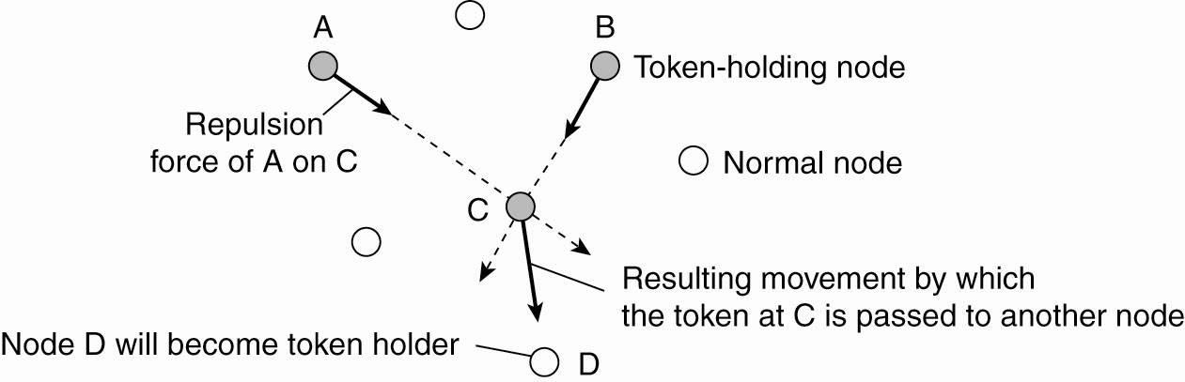
Elections in Large-Scale Systems (2)
Moving tokens in a two-dimensional space
using repulsion forces

Slide 68
Introduction to Transactions
Related to Mutual Exclusion, which protects a “shared resource”.
Transactions protect “shared data”.
Often, a single transaction contains a collection of
data accesses/modifications.
The collection is treated as an “atomic operation” – either all the collection complete, or none of them do.
Mechanisms exist for the system to revert to a previously “good state” whenever a transaction prematurely aborts.

Slide 69
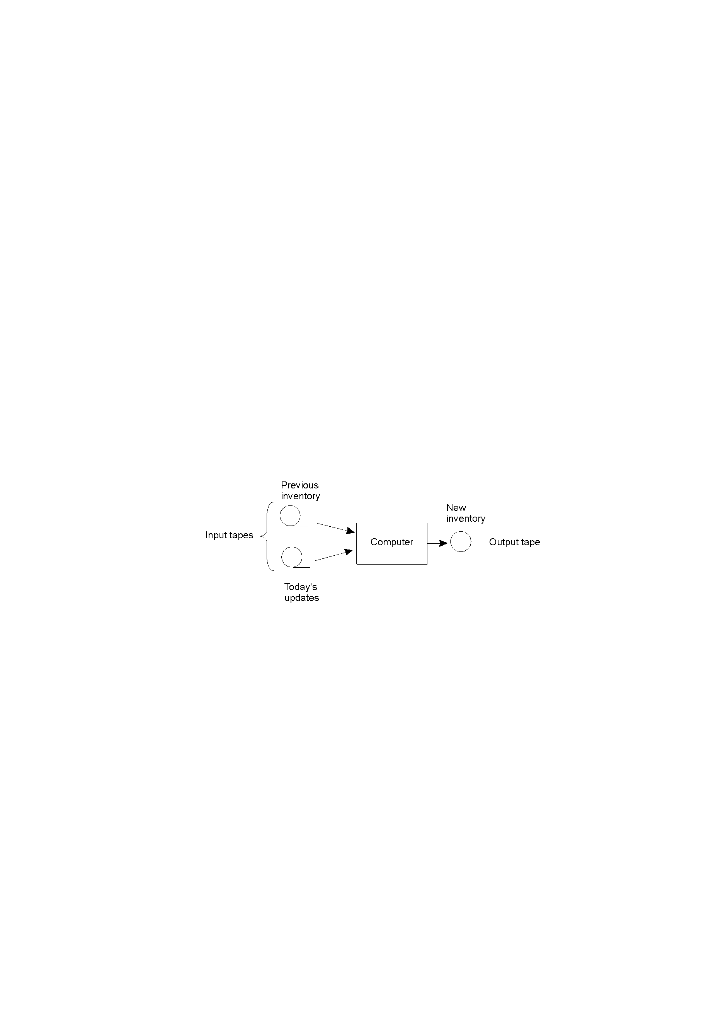
The Transaction Model (1)
Updating a master tape is fault tolerant.

Slide 70
The Transaction Model (2)
Examples of primitives for transactions.
Primitive | Description
BEGIN_TRANSACTION | Make the start of a transaction
END_TRANSACTION | Terminate the transaction and try to commit
ABORT_TRANSACTION | Kill the transaction and restore the old values
READ | Read data from a file, a table, or otherwise
WRITE | Write data to a file, a table, or otherwise

Slide 71
The Transaction Model (3)
BEGIN_TRANSACTION reserve WP -> JFK; reserve JFK -> Nairobi; reserve Nairobi -> Malindi; END_TRANSACTION (a) | BEGIN_TRANSACTION reserve WP -> JFK; reserve JFK -> Nairobi; reserve Nairobi -> Malindi full => ABORT_TRANSACTION (b)
Transaction to reserve three flights “commits”.
Transaction “aborts” when third flight is unavailable.

Slide 72
A.C.I.D.
Four key transaction characteristics:
Atomic: the transaction is considered to be one thing, even though it may be made of up many different parts.
Consistent: “invariants” that held before the transaction must also hold after its successful execution.
Isolated: if multiple transactions run at the same time, they must not interfere with each other. To the system, it should look like the two (or more) transactions are executed sequentially (i.e., that they are serializable).
Durable: Once a transaction commits, any changes are permanent.

Slide 73
Types of Transactions
Flat Transaction: this is the model that we have looked at so far. Disadvantage: too rigid. Partial results cannot be committed. That is, the “atomic” nature of Flat Transactions can be a downside.
Nested Transaction: a main, parent transaction spawns child sub-transactions to do the real work. Disadvantage: problems result when a sub-transaction commits and then the parent aborts the main transaction. Things get messy.
Distributed Transaction: this is sub-transactions operating on distributed data stores. Disadvantage: complex mechanisms required to lock the distributed data, as well as commit the entire transaction.

Slide 74
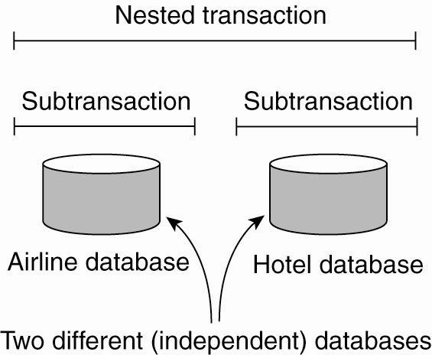
Nested Transaction
A nested transaction

Slide 75
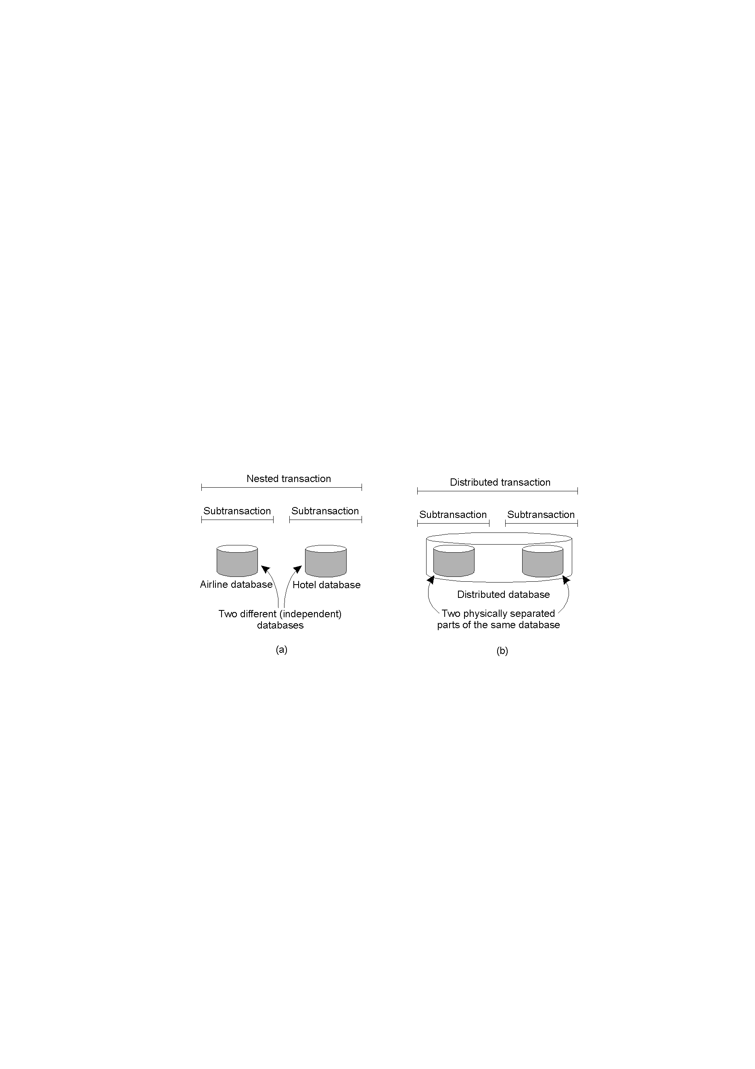
Nested vs. Distributed Transactions
A distributed transaction – logically a flat, indivisible transaction that operates on distributed data.

Slide 76
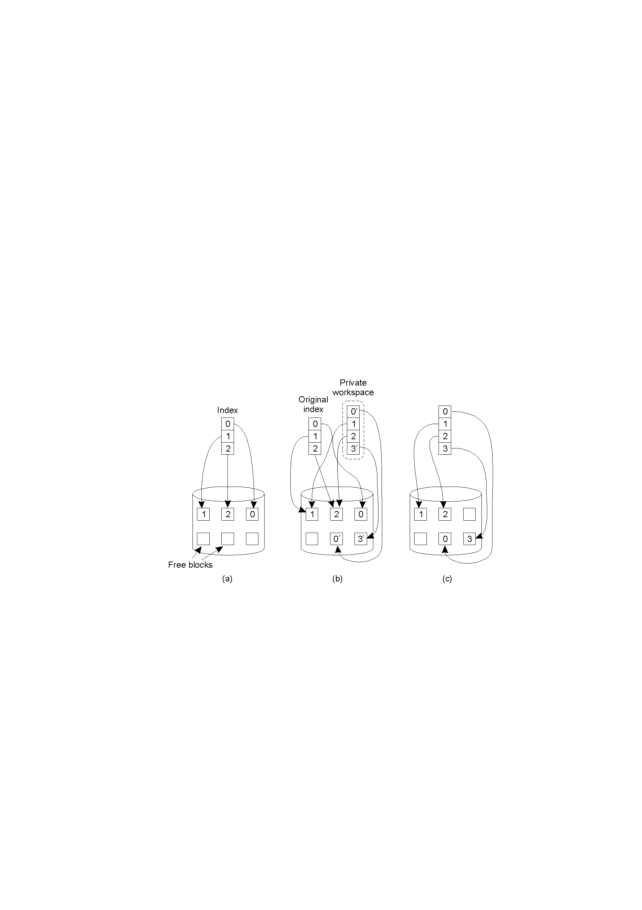
Private Workspace
The file index and disk blocks for a three-block file
The situation after a transaction has modified block 0 and appended block 3
After committing

Slide 77
Writeahead Log
x = 0; y = 0; BEGIN_TRANSACTION; x = x + 1; y = y + 2 x = y * y; END_TRANSACTION; (a) | Log [x = 0 / 1] (b) | Log [x = 0 / 1] [y = 0/2] (c) | Log [x = 0 / 1] [y = 0/2] [x = 1/4] (d)
a) A transaction
b) – d) The log before each statement is executed

Slide 78
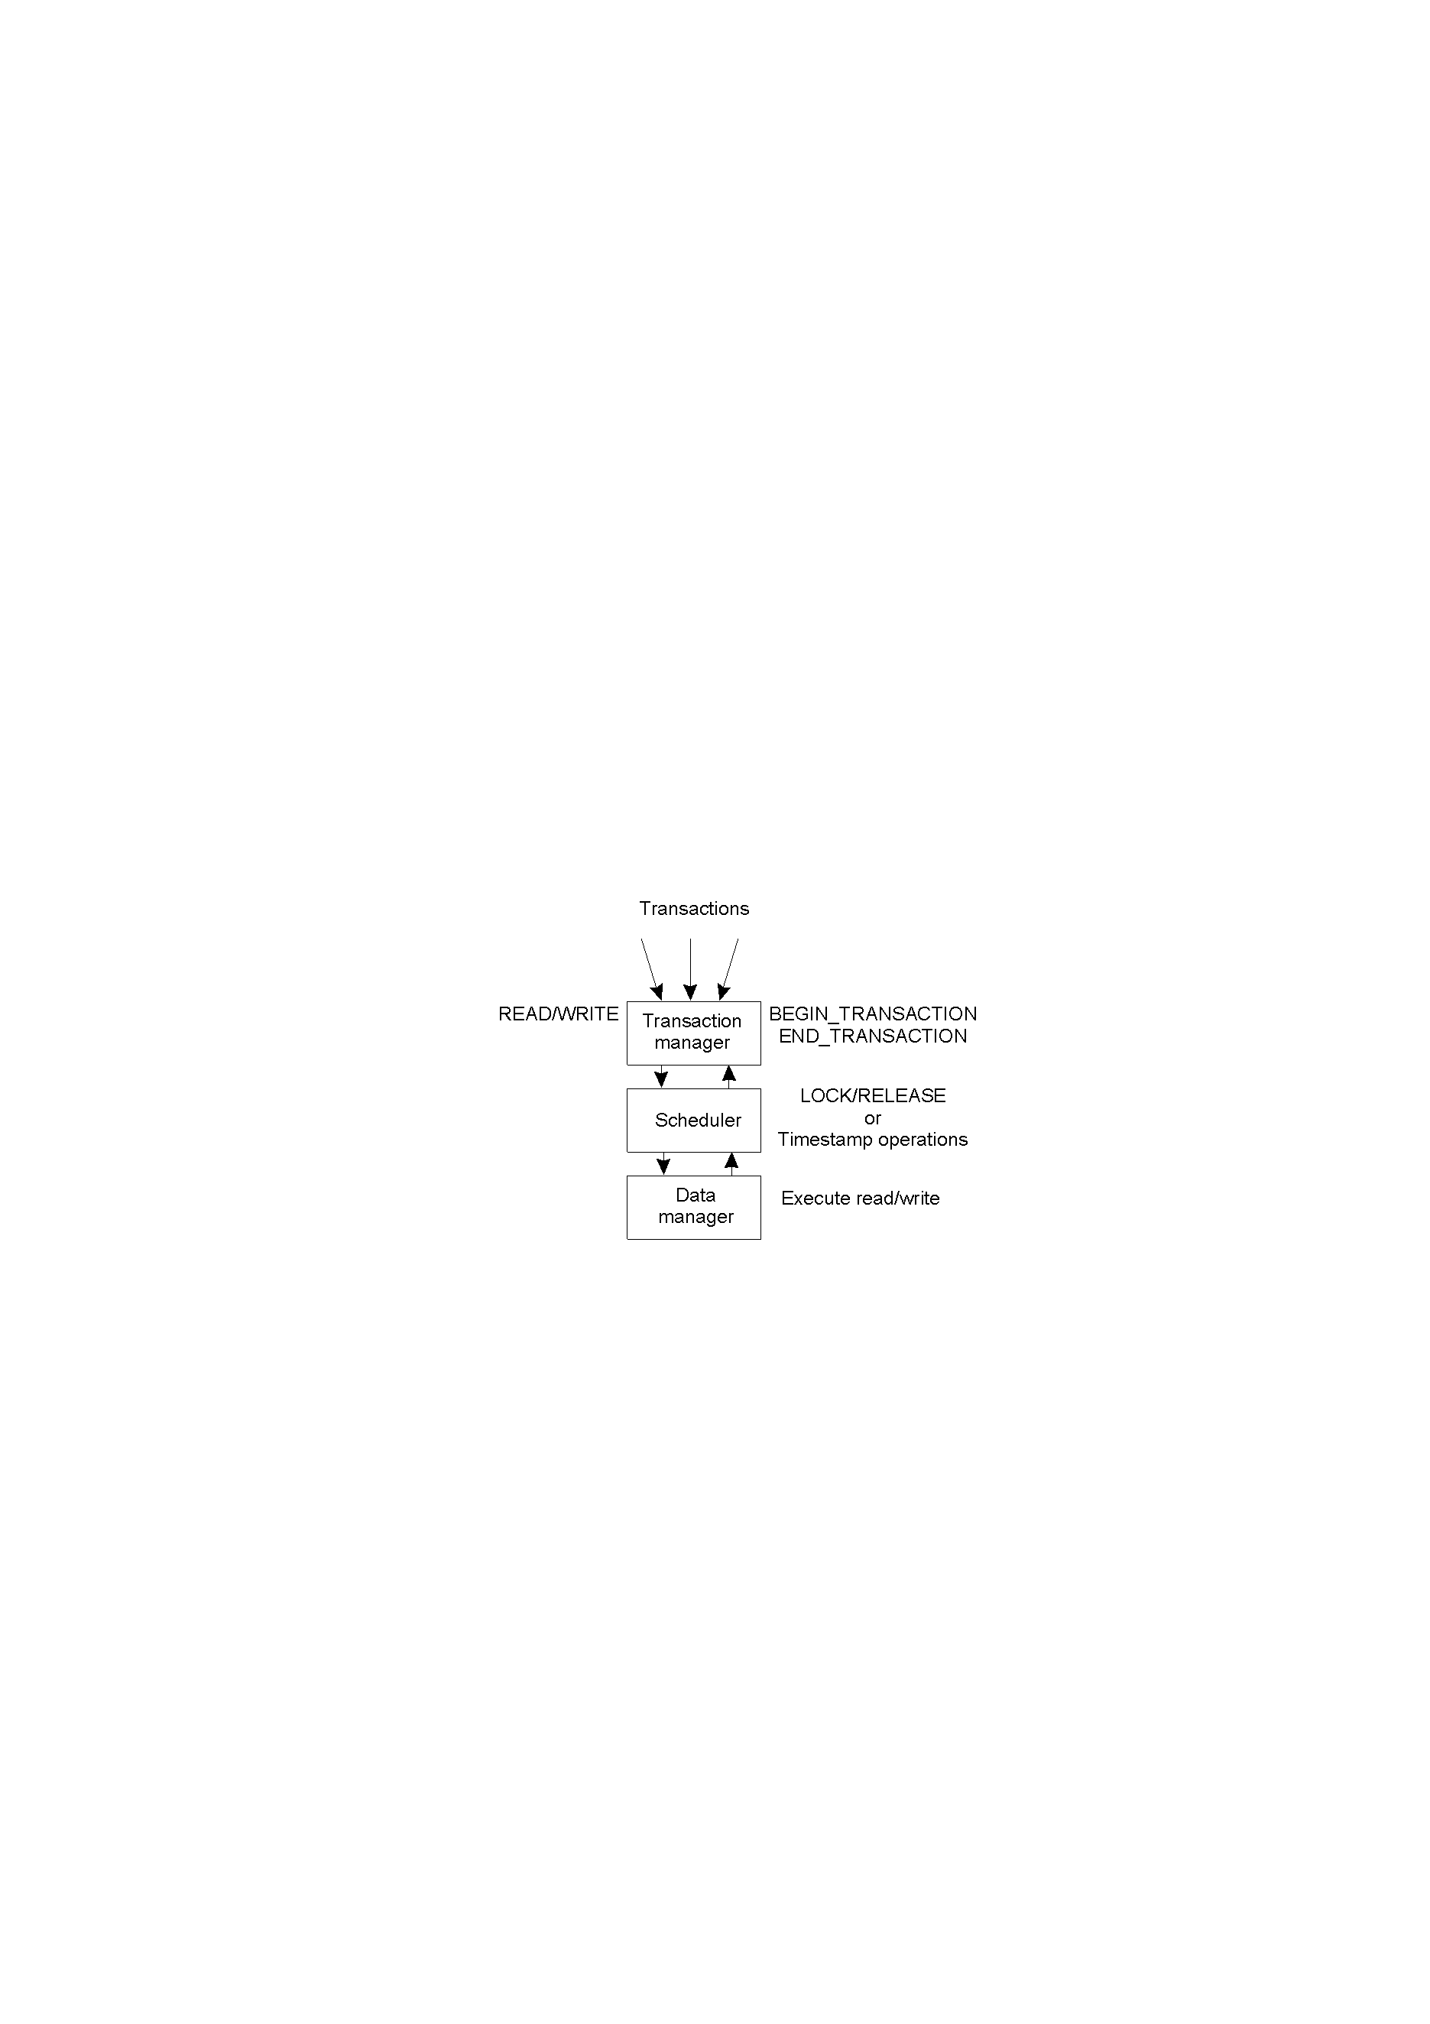
Concurrency Control (1)
General
organization of
managers for
handling
transactions.

Slide 79
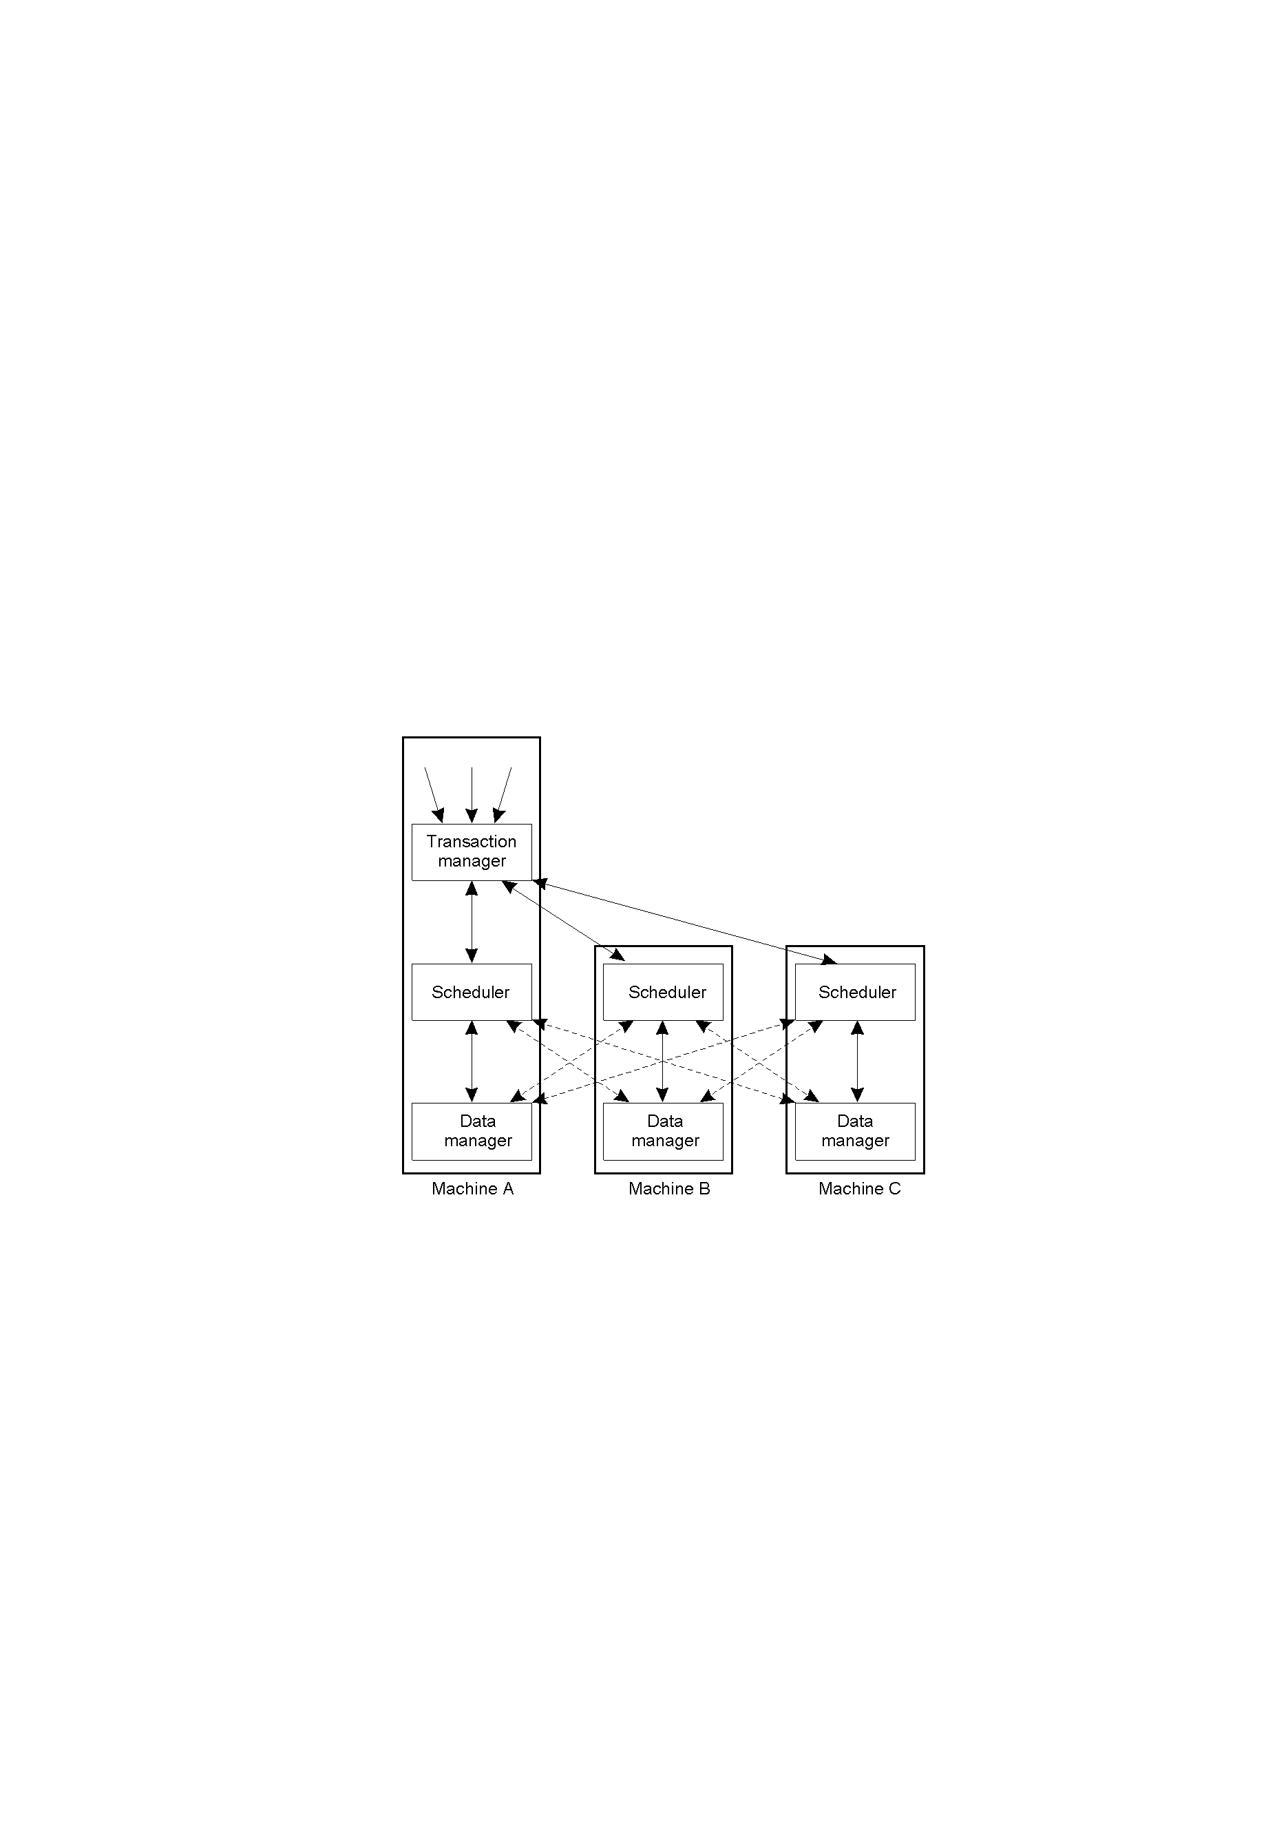
Concurrency Control (2)
General organization of managers
for handling distributed
transactions.

Slide 80
Serializability
BEGIN_TRANSACTION x = 0; x = x + 1; END_TRANSACTION (a) | BEGIN_TRANSACTION x = 0; x = x + 2; END_TRANSACTION (b) | BEGIN_TRANSACTION x = 0; x = x + 3; END_TRANSACTION (c)
Schedule 1 | x = 0; x = x + 1; x = 0; x = x + 2; x = 0; x = x + 3 | Legal
Schedule 2 | x = 0; x = 0; x = x + 1; x = x + 2; x = 0; x = x + 3; | Legal
Schedule 3 | x = 0; x = 0; x = x + 1; x = 0; x = x + 2; x = x + 3; | Illegal
(d)
a) – c) Three transactions T₁, T₂, and T₃
d) Possible schedules

